Slide 1
Data Analysis Dashboard
Sales Insights Using Power BI
Shiva Sumedha

Slide 2
Dataset Overview
• The dataset contains sales data of a retail business
• Key attributes include:
- Category
- Region
- Order Date
- Sales
• Data was cleaned and prepared for analysis
• This dataset is used to analyze sales trends and performance

Slide 3

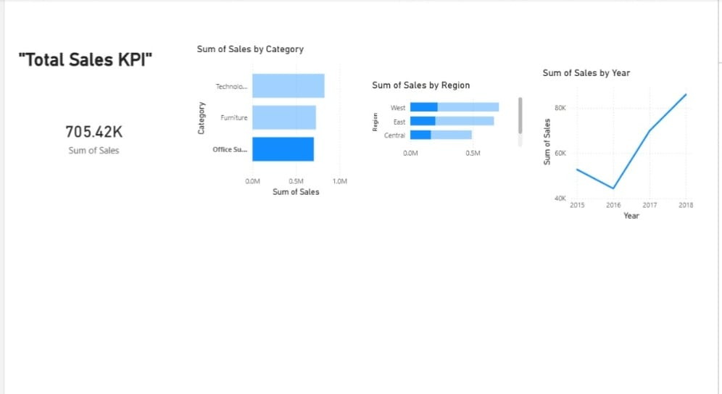
Dashboard Overview
• The dashboard provides a visual representation of sales data
• It includes:
- Total Sales KPI
- Sales by Category
- Sales by Region
- Sales Trend over Years
• Helps in identifying key insights and patterns
• Enables better business decision making

Slide 4

Key Insights & Findings
• Technology category has the highest sales
• West region generates the most revenue
• Sales show an increasing trend over the years
• Furniture and Office Supplies have moderate performance
• Overall business performance is improving

Slide 5
Hypothesis
• Sales have increased over time
• Higher sales indicate business growth
• Technology category contributes maximum revenue
• West region shows strong performance
• Overall data supports positive business growth

Slide 6
Conclusion
• The analysis shows that sales performance is improving over time
• Technology category generates the highest revenue
• West region contributes the most to overall sales
• Sales trends indicate steady business growth
• The dashboard helps in making effective data-driven decisions

Slide 7
.
Thank You
For Your Time & Attention

